Slide 1

HUMAN ACTION
RECOGNITION
(USING 3D CNN)
BY-ABHINAV KUMAR
SUPERVISOR: Dr. Parashjyoti Borah

Slide 2


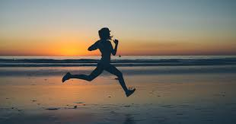
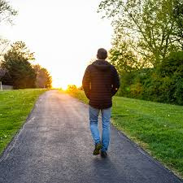
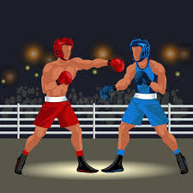
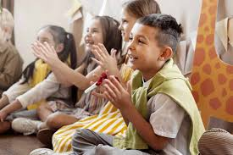
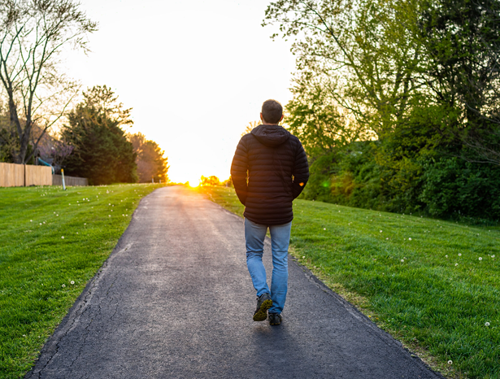
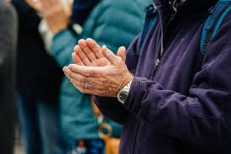
AIM
Recognizing different human actions from images or videos.
EXAMPLE:
BOXING
HANDCLAPPING
RUNNING
WALKING

Slide 3
WHY DO WE NEED THIS?
Remote Patient Monitoring
Elderly Care
Fitness Tracking
Safety Monitoring
Surveillance and Security
etc...

Slide 4
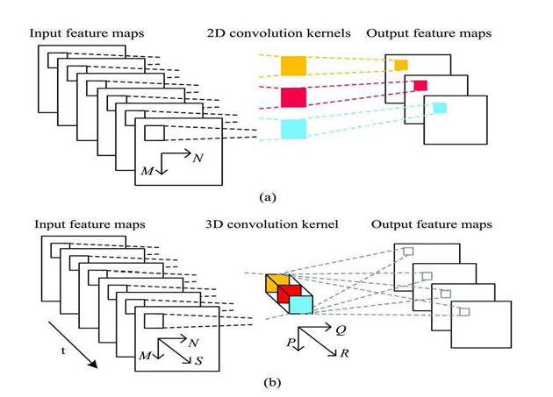
WHY 3D CNN?

Slide 5
3D CNN model uses two CNN streams:
SPATIAL STREAM
It process individual RGB frame to capture object and scene appearance.
TEMPORAL STREAM
It uses optical flow between frames to capture motion information
NOTE:2D CNNs operate on individual frames or images, treating each frame independently. They excel at extracting spatial features (e.g., shapes, textures) but fail to capture the temporal relationships

Slide 6
METHODOLOGY
DATASET
KTH
JHMDB
HMDB
CAVIAR
PREPROCESSING
Extract_frames:Divide the videos into frames
OpenCV: converts the color space from BGR to RGB
Normalization: Pixel values are normalized to improve model performance.

Slide 7
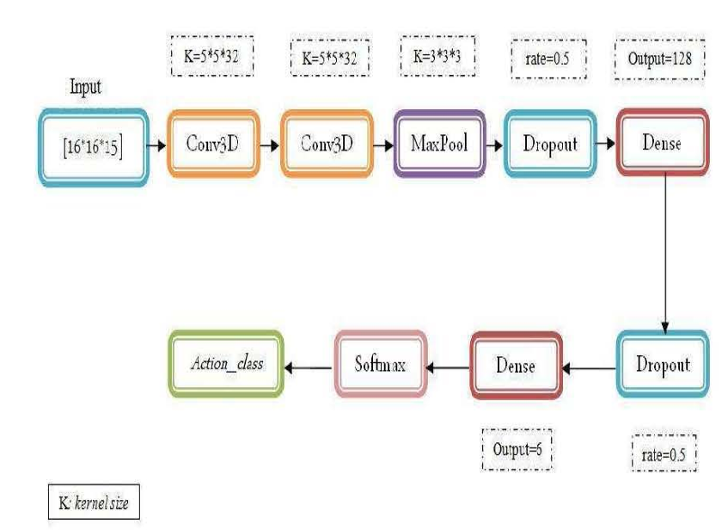
WORKING

Slide 8
TOOLS
TENSERFLOW : A deep learning framework for building and training neural networks
MAXPOOLING: to reduce the dimentionality of image
DROPOUT: prevent overfitting
SOFTMAX: converts the raw output scores from the model into probabilities that sum to 1.
Dense: Fully connected layer for classification.
Flatten: Flattens the input for feeding into dense layers
K-Fold Cross-Validation:model's performance is evaluated robustly and that the results are not biased by a specific train-test split.

Slide 9
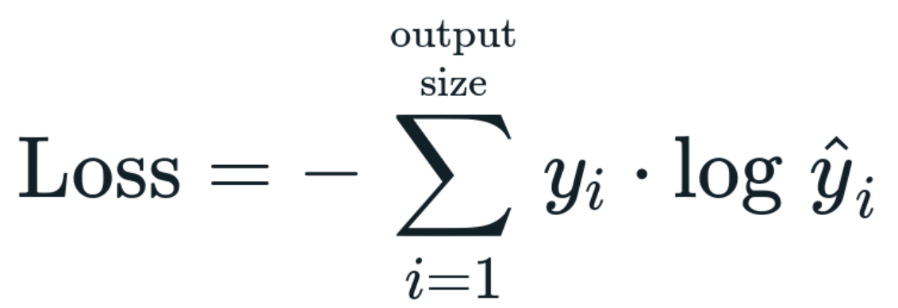
LOSS FUNCTION
CATEGORICAL CROSS ENTROPY
yi​: The true label (ground truth) for class i
yi(cap): is the predicted probability for class i
n: The total number of classes.

Slide 10
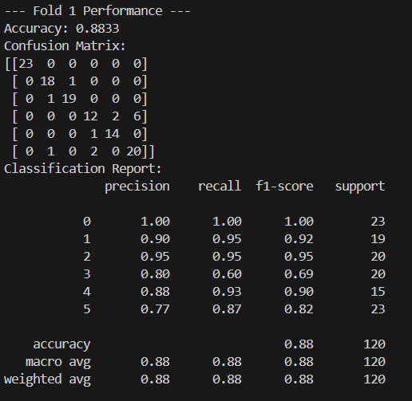
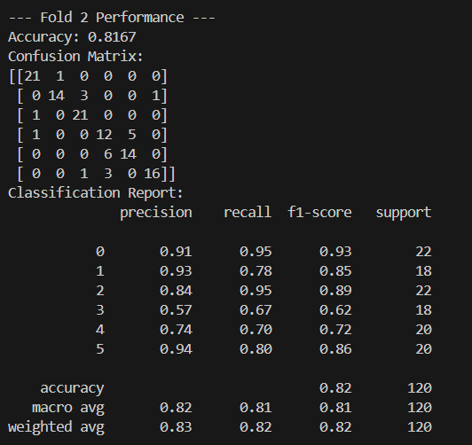
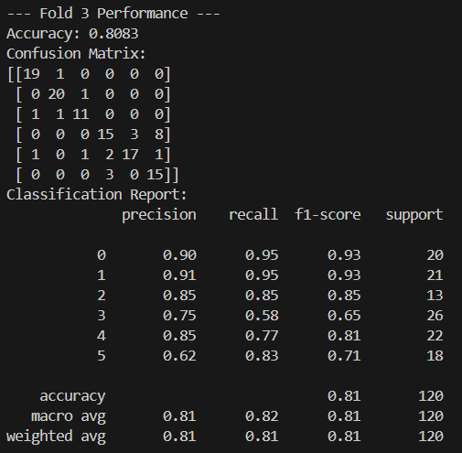
IMPLEMENTATION AND PERFORMANCE
implemented basic code ..
Fold1 performance
Fold2 performance
Fold3 performance

Slide 11
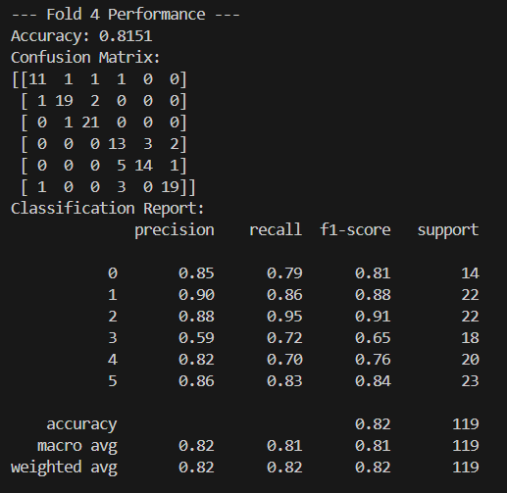
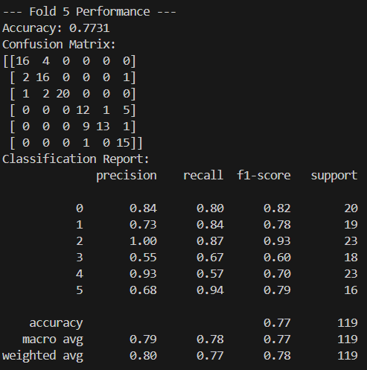
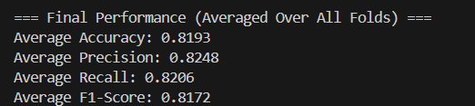
Fold4 performance
Fold5 performance
Final performance(average)

Slide 12
FUTURE CHALLENGES
Preprocessing video data for 3D CNNs is more complex than for 2D CNNs.
Example: Resizing video frames to a fixed resolution
3D CNNs are computationally expensive, making real-time action recognition difficult.
Example: surveillance require low-latency which is
challenging.
Hardware Limitations
Challenge: Training and deploying 3D CNNs require
powerful hardware (e.g., GPUs or TPUs)

Slide 13
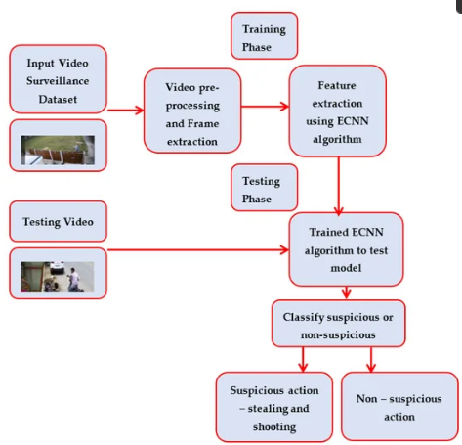
FUTURE WORK
exploring(3D CNN + LSTM)
Suspicious Activity Detection from Surveillance Video

Slide 14
REFERENCES
3D CNN for Human Action Recognition Publisher: IEEE Sameh Neili Boualia; Najoua Essoukri Ben Amara
Human action recognition with 3D convolutional neural network Publisher: IEEE Cite Tiago Lima; Bruno Fernandes; Pablo Barros
Spatio-Temporal Attention Networks for Action Recognition and Detection Publisher: IEEE Cite This PDF Jun Li; Xianglong Liu; Wenxuan Zhang; Mingyuan Zhang; Jingkuan Song; Nicu Sebe
Deep Learning Approach for Suspicious Activity Detection from Surveillance Video Publisher: IEEE Cite C.V Amrutha; C. Jyotsna; J. Amudha
image sources: google.com

Slide 15
THANK YOU

